Slide 1



Slide 2


INDEX
1
INTRODUCTION
ARCHITECTURE OVERVIEW
SOFTWARE & SCALABILITY
LAMP
LINUX&APACHE
MYSQL
PHP & HIPHOP
DISADVANTAGES OF LAMP
MEMCACHED
HADOOP ECOSYSTEM
HADOOP HIVE
TRIFT
BIGPIPE
SCRIBE
VARNISHCACHE
HAYSTACK
MESSAGES
CHAT
CASSANDRA
MARKETING
CREDITS
2
3
4
5

Slide 3
INTRODUCTION
IS AN ONLINE SOCIAL NETWORKING SERVICE,
A PLATFORM TO BUILD SOCIAL RELATIONS
FOUNDED IN 2004
CEO: MARK ZUCKERBERG

Slide 4



Scaling challenge
MORE THAN 60.000 SERVERS
THE LAST DATACENTER IS BASED ON ENTIRELY SELF-DESIGN HARDWARE THAT WAS RECENTLY UNVEILED AS “OPEN COMPUTE PROJECT”
300 TB OF DATA STORED IN MEMCACHE PROCESSES

Slide 5


THE HADOOP AND HIVE CLUSTER IS MADE OF 300.000 SERVERS WITH 8 CORES, 32GB RAM, 12TB DISKS
TOTAL: 24.000 CORES, 96TB RAM AND 36PB DISKS
100BILLION HITS, 50BILLION PHOTOS, 3TRILLION OBJECTS CACHED, 130TB OF LOGS PER DAY

Slide 6





ARCHITECTURE OVERVIEW
Front end & Back end
VISITORS
WEB SERVER
STAFF
FRONT
END
presentation
layer
BACK
END
presentation
layer
DATA
BASE
Business &
data access
layers

Slide 7
SOFTWARE & SCALABILITY
Software that helps Facebook to scale
IN SOME WAYS FACEBOOK IS STILL A LAMP SITE , BUT IT HAS HAD TO CHANGE AND EXTEND ITS OPERATION TO INCORPORATE A LOT OF OTHER ELEMENTS AND SERVICES, AND MODIFY THE APPROACH TO EXISTING ONES
NOW WE WILL SEE SOME OF THE SOFTWARE THAT HELPS FACEBOOK SCALE

Slide 8
LAMP
4 COMPONENTS OF A SOLUTION STACK
COMPOSED ENTIRELY OF FREE AND OPEN SOURCED SOFTWARE
SUITABLE FOR BUILDING HIGH-AVAILABILITY HEAVY-DUTY DYNAMIC WEBSITES
CAPABLE OF SERVING TENS OF THOUSANDS OF REQUESTS SIMULTANEOUSLY

Slide 9


LINUX & APACHE
LINUX
IT IS A UNIX-LIKE OPERATING SYSTEM KERNEL
IT IS OPEN SOURCED, HIGHLY CUSTOMIZABLE, AND SECURE.
APACHE HTTP
FACEBOOK RUNS THE LINUX OPERATING SYSTEM APACHE HTTP SERVER WHICH IS ALSO FREE AND IS THE
MOST POPULAR OPEN SOURCE WEB SERVER IN USE

Slide 10

MySQL
Database
IT IS USED PRIMARILY AS A KEY STORE OF VALUE WHEN THE DATA ARE RANDOMLY DISTRIBUTED AMONG A LARGE NUMBER OF CASES LOGICAL.
THIS LOGICAL INSTANCES EXTEND ACROSS PHYSICAL NODES AND LOAD BALANCING IS DONE AT PHYSICAL NODE.
CUSTOMIZATION
FACEBOOK HAS DEVELOPED A CUSTOM PARTITIONING SCHEME WHICH IS ASSIGNED A GLOBAL ID FOR ALL DATA.
THEY ALSO HAVE A CUSTOM SCHEMA FILE THAT IS BASED ON THE AMOUNT OF COMMON DATA AND THE LATEST IS ON A PER USER BASIS. MOST OF THE DATA ARE RANDOMLY DISTRIBUTED
SPEED
RELIABILITY

Slide 11
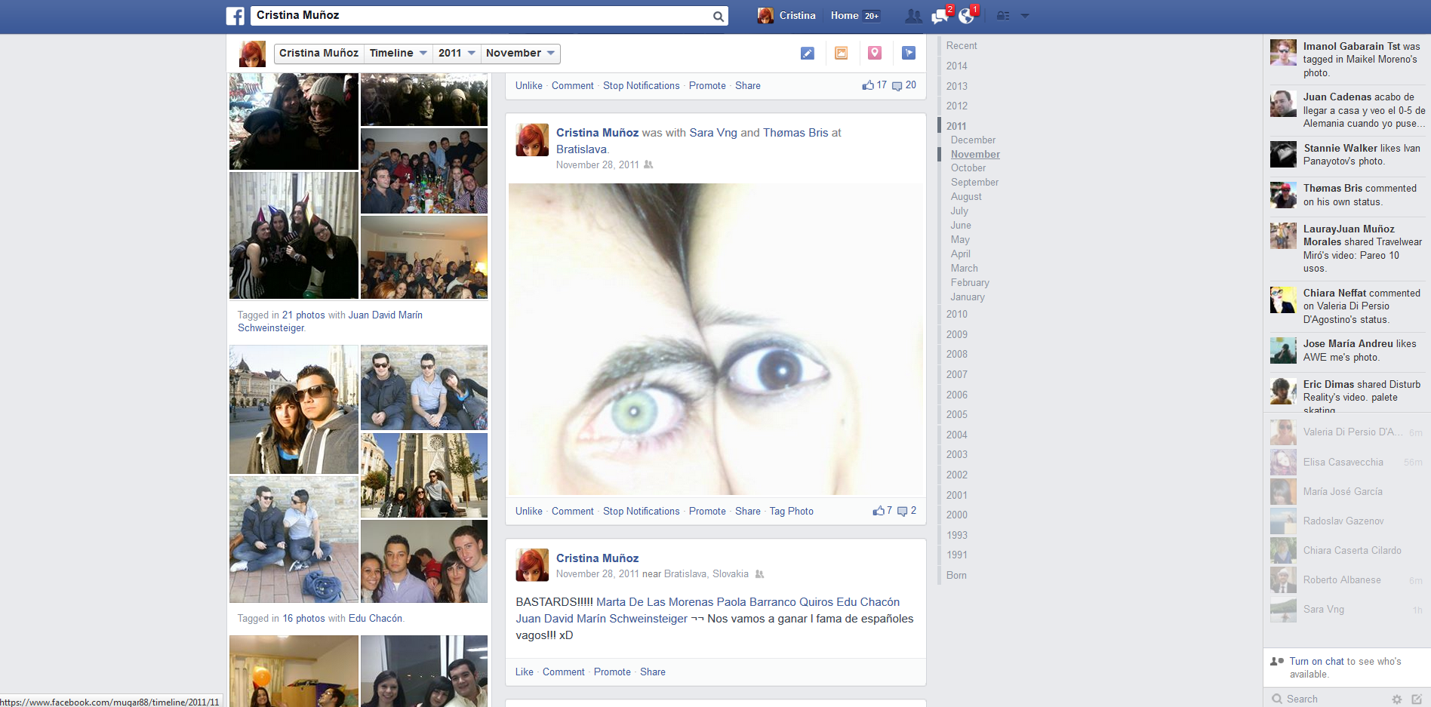

Slide 12
PHP & HIPHOP
IT IS A GOOD WEB PROGRAMMING LANGUAGE WITH EXTENSIVE SUPPORT, ACTIVE DEVELOPER COMMUNITY AND RAPID INTERACTION. IT IS A DYNAMICALLY TYPED LANGUAGE (INTERPRETER).
FACEBOOK’S HIPHOP IS A SOURCE CODE TRANSFORMER THAT CONVERTS THE PHP INTO C++ AND COMPILES IT USING G++, THUS PROVIDING A
HIGH PERFORMANCE TEMPLATING A WEB LOGIC EXECUTION LAYER
PRE-
OPTIMIZER
TYPE
INFERENCE
ENGINE
PARSER
STATIC
ANALYZER
POST-
OPTIMIZER
CODE
GENERATOR
g++

Slide 13



DISADVANTAGES OF LAMP
FACEBOOK HAS REALIZED THAT THERE ARE DISADVANTAGES TO USING THE LAMP STACK, IS NOT NECCESSARILY OPTIMIZED FOR WEBSITES SIZE AND THEREFORE DIFFICULT TO SCALE.
IT IS THE FASTEST EXECUTING LANGUAGE AND THE FRAMEWORK OF THE EXTENSION IS DIFFICULT TO USE
HTTP Request
HTTP Request
API/FQL
Web/App
Server
HTML
Browser
Response
FBML
Database

Slide 14

MemCached
CACHING SYSTEM
IT IS USED TO ACCELERATE DYNAMIC WEBSITES WITH DATABASES (LIKE FB)
CACHING THAT DATA AND OBJECTS IN RAM TO REDUCE READING TIME, IS THE MAIN FORM OF CACHING FACEBOOK AND
HELPS RELIEVE THE BURDEN OF DATABASE
HAVING A CACHE SYSTEM ALLOWS FACEBOOK TO BE AS FAST AS IT IS TO REMEMBER YOUR INFORMATION. IF YOU DON’T HAVE TO GO TO THE DATABASE YOU JUST COLLECT DATA FROM THE CACHE BASED ON USERNAME.

Slide 15
CLIENT
PUT/GET/REMOVE
(Sync)
SERVER
MemCached
Server Partition 1
Web
Server
1
MemCached
Server Partition 2
Web
Server
2
MemCached
MemCached
Server Partition 3
Web
Server
3
MemCached
Server Partition 4

Slide 16

HADOOP ECOSYSTEM
Data management
APACHE HADOOP IS AN OPEN-SOURCE FREE FRAMEWORK FOR STORAGE AND LARGE-SCALE PROCESSING OF DATA-SETS ON CLUSTERS OF COMMODITY HARDWARE
IT EXISTS WITHIN A RICH ECOSYSTEM OF TOOLS FOR PROCESSING AND ANALYZING LARGE DATA SETS

Slide 17
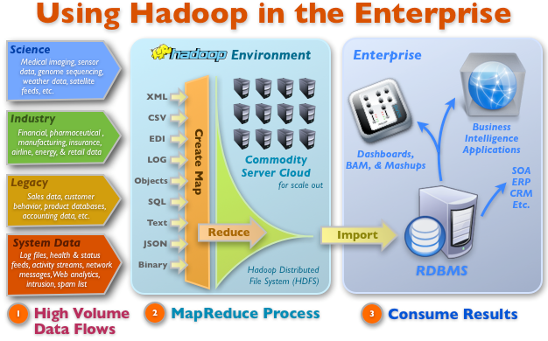

Slide 18

HADOOP HIVE
APACHE HIVE IS A DATA WAREHOUSE INFRASTRUCTURE BUILT ON TOP OF HADOOP FOR PROVIDING DATA SUMMARIZATION, QUERY AND ANALYSIS, DEVELOPED BY FB
HIVE ALLOWS USERS TO
EXPLORE AND STRUCTURE
THAT DATA, ANALYZE IT
AND THEN TURN IT INTO
BUSINESS INSIGHT
HADOOP WAS BUILT TO
ORGANIZE AND STORE
MASSIVE AMOUNTS OF
DATA
SCALABLE &
EXTENSIBLE
FAMILIAR
FAST
INFORMATIVE

Slide 19

THRIFT
Protocol
IT IS A LIGHTWEIGHT REMOTE PROCEDURE CALLED FRAMEWORK FOR SCALABLE CROSS-LANGUAGE SERVICES DEVELOPMENT
IT SUPPORTS C++, PHP, PYTHON, PEARL, JAVA, RUBY, ERLANG…
PROVIDES A WORKING DIVISION OF LABOR IN HIGH-PERFORMANCE SERVERS AND APPLICATIONS
SAVES DEVELOPMENT TIME
FAST

Slide 20
BIGPIPE
CUSTOM TECHONOLOGY TO ACCELERATE PAGE RENDERING USING A PIPELINING LOGIC
THE GENERAL IDEA IS TO DECOMPOSE WEB PAGES INTO SMALL CHUNKS CALLED PAGELETS AND PIPELINE THEM THROUGH SEVERAL EXECUTION STAGES INSIDE WEB SERVERS AND BROWSERS
INCREASES PERFORMANCE
&
INCREASES SPEED

Slide 21
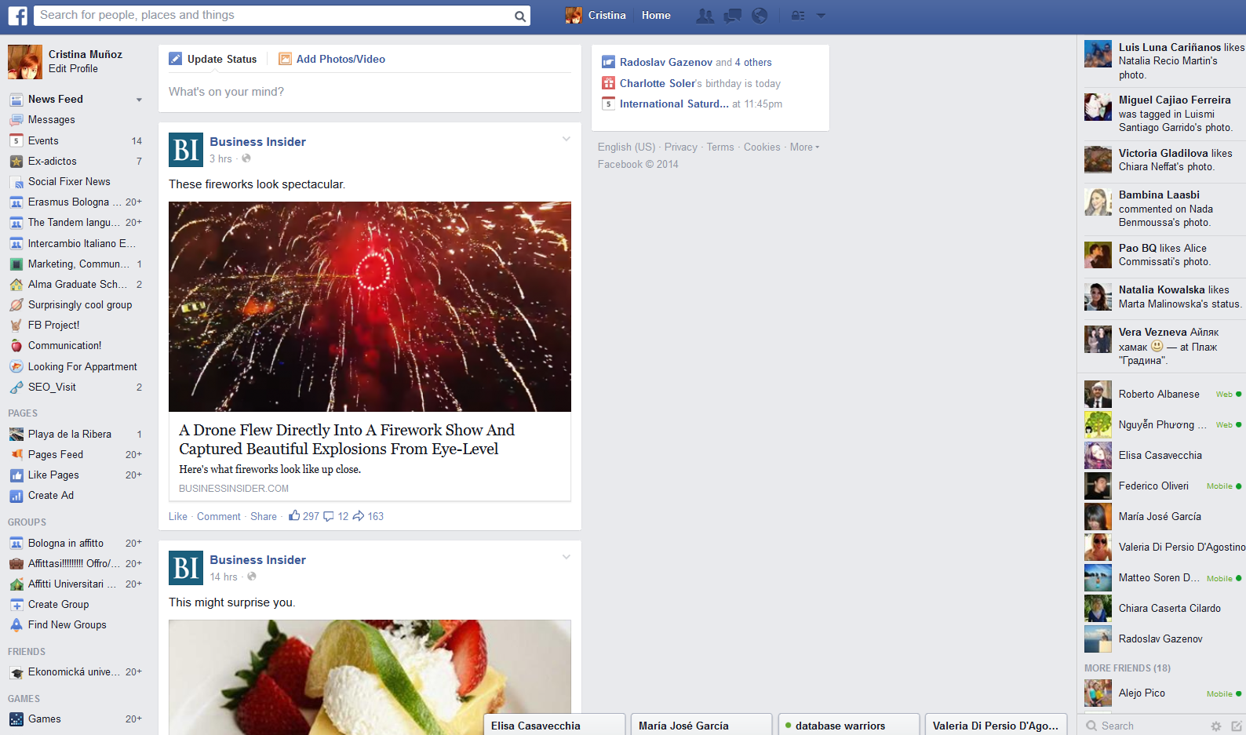

Slide 22
SCRIBE
Server logs
IT IS A SERVER FOR AGGREGATING LOG DATA STREAM IN REAL TIME ON MANY OTHER SERVERS, IT IS SCALABLE FRAMEWORK USEFUL FOR RECORDING A WIDE RANGE OF DATA.
IT IS BUILT ON TOP OF SAVINGS.
DATA SUCH AS LOGIN, CLICKS AND FEEDS TRANSIT USING SCRIBE AND ARE AGGRAVATING AND STORED IN HDFS USING SCRIBE-HDFS, ALLOWING EXTENDED ANALYSING USING MAPREDUCE

Slide 23

MOVES DATA FROM THE SERVER
TO A CENTRAL REPOSITORY

Slide 24

VARNISH CACHE
IT IS USED FOR HTTP PROXYING
THEY HAVE IT FOR ITS HIGH PERFORMANCE AND EFFICIENCY
Request
Web
Server
Caching
Proxy
Response
WEB APPLICATION ACCELERATOR

Slide 25
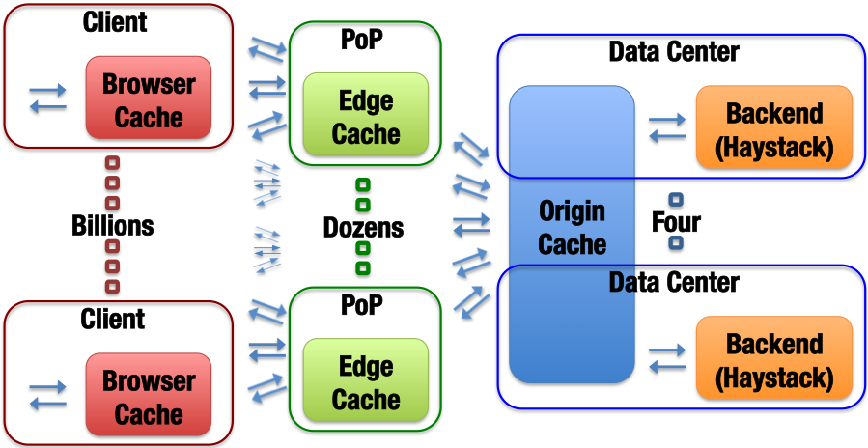
HAYSTACK
THE STORAGE OF THE BILLIONS OF PHOTOS POSTED BY USERS IS HANDLED WITH THIS AD-HOC STORAGE SOLUTION DEVELOPED BY FACEBOOK WHICH BRINGS LOW LEVEL OPTIMIZATIONS AND APPEND-ONLY WRITES

Slide 26
IT WAS DESIGNED TO SERVE THE LONG TAIL OF REQUESTS SEEN BY SHARING PHOTOS IN A LARGE SOCIAL NETWORK
AN OBJECT STORAGE SYSTEM DESIGNED FOR FACEBOOK’S PHOTOS APPLICATION
THE KEY INSIGHT IS TO AVOID DISK OPERATIONS WHEN ACCESSING META-DATA
HAYSTACK PROVIDES A FAULT-TOLERANT AND SIMPLE SOLUTION TO PHOTO STORAGE AT DRAMATICALLY LESS COST AND HIGHER THROUGHPUT THAN A TRADITIONAL APPROACH USING NAS APPLIANCES
INCREMENTALLY
SCALABLE
NECESSARY QUALITY AS OUR USERS UPLOAD HUNDREDS OF MILLIONS OF PHOTOS EACH WEEK

Slide 27

MESSENGER
IT IS USING ITS OWN ARCHITECTURE WHICH IS NOT NOTABLY BASED ON INFRASTRUCTURE SHARDING AND DYNAMIC CLUSTER MANAGEMENT
BUSINESS LOGIC AND PERSISTENCE IS ENCAPSULATED IN SO CALLED “CELL”
EACH CELL HANDLES A PART OF USERS; NEW CELLS CAN BE ADD AS POPULARITY GROWS. PERSISTENCE IS ACHIEVED USING HBASED, WHICH STORES ALSO AN INVERTED INDEX FOR EACH SEARCH ENGINE.

Slide 28
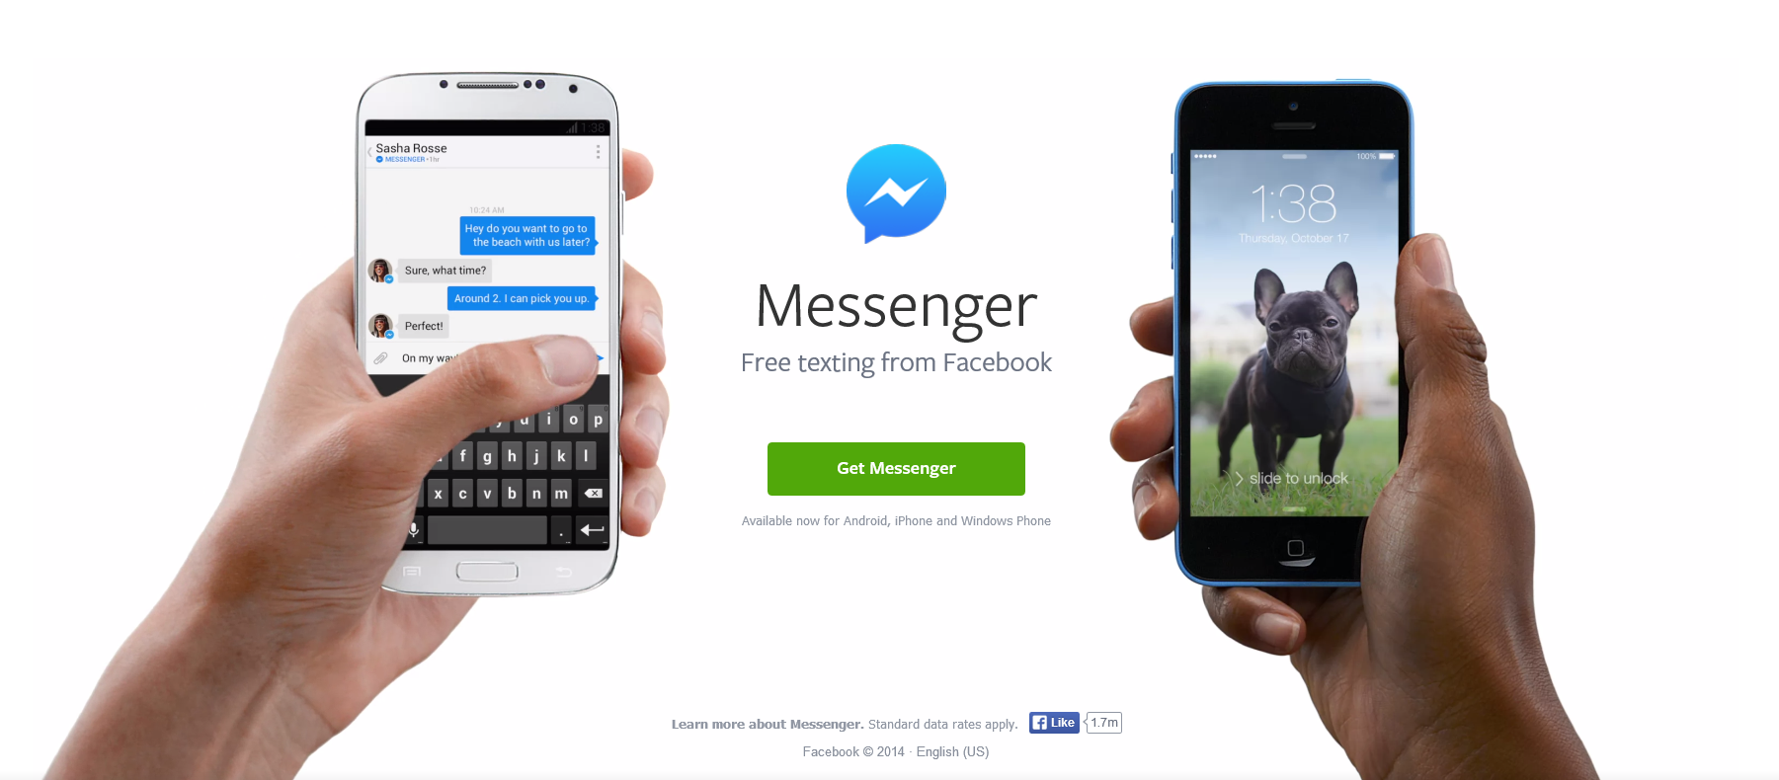

Slide 29
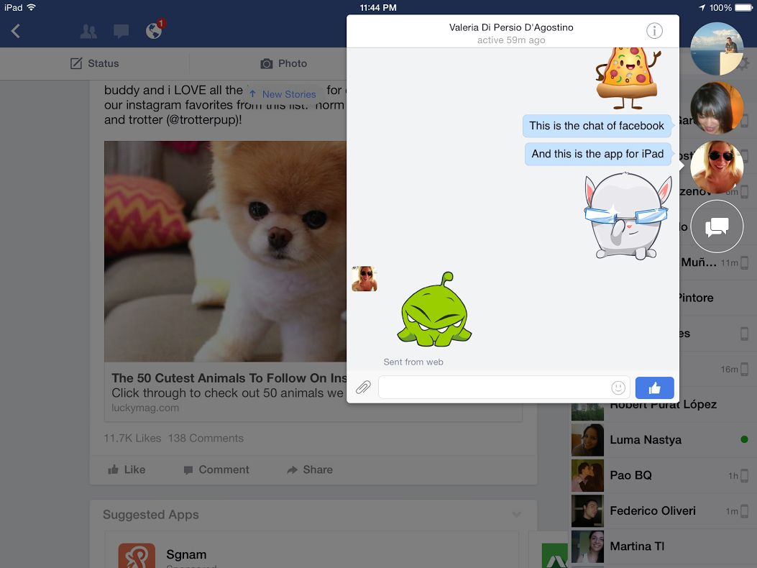
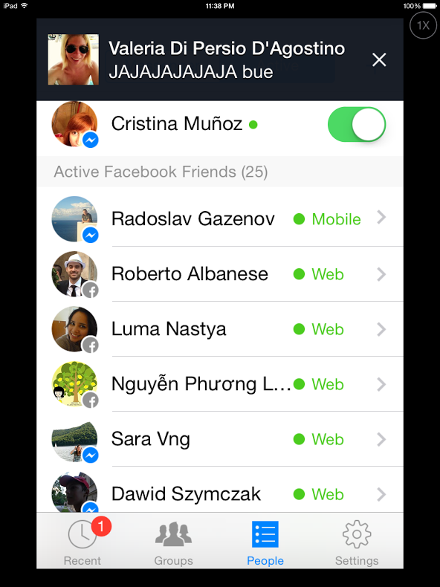
THIS IS ‘MESSENGER’
FOR PORTABLE DEVICES
THIS IS THE APPLICATION FOR IPAD

Slide 30

CHAT
BASED ON AN EPOLL SERVER
DEVELOPED IN ERLANG
ACCESSED USING THRIFT

Slide 31
CASSANDRA
Database
DESIGNED TO HANDLE LARGE AMOUNT OF DATA SPLIT OUT ACROSS MANY SERVERS
THE FUNCTION OF THE POWER OF FACEBOOK INBOX SEARCH AND PROVIDES A STRUCTURE OF KEY-VALUE STORE WITH EVENTUAL CONSISTENCY

Slide 32

HIGH
PERFORMANCE
OPEN
SOURCE
COLUMN
ORIENTED
TUNABLE
CONSISTENCY
P2P
ARCHITECTURE
SCHEMA
FREE
HIGH
AVAILABILITY
ELASTIC
SCALABILITY

Slide 33
Architecture
Cassandra API
Tools
Storage Layer
Partitioner
Replicator
Failure detector
Cluster Membership
Messaging Layer

Slide 34
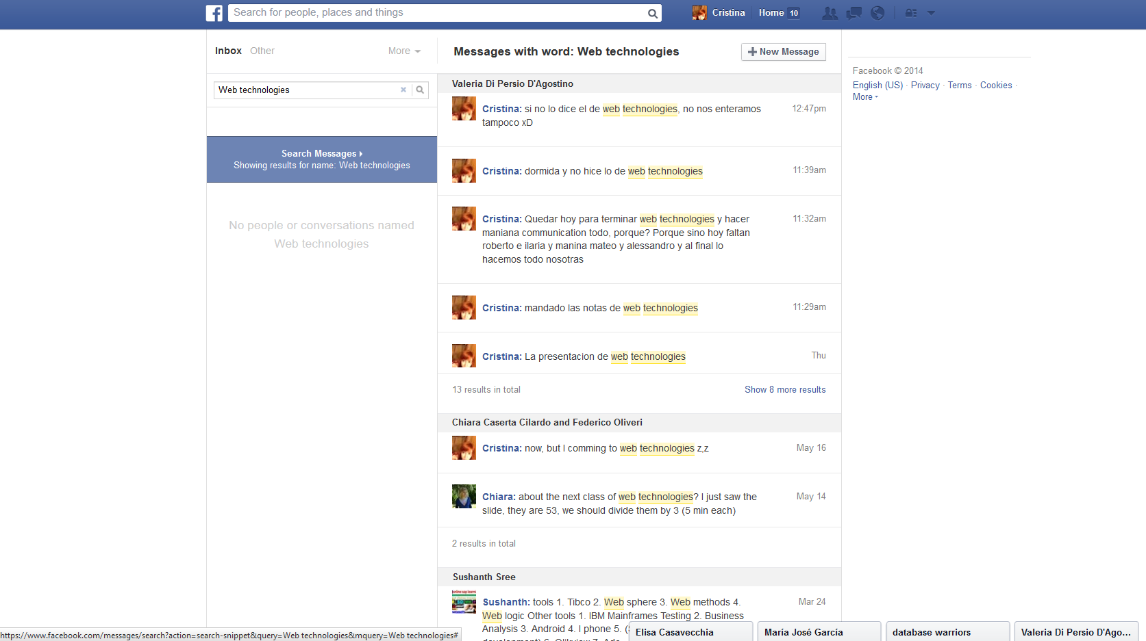
Inbox Search

Slide 35
MARKETING
Why is important for businesses?
GREAT SPACE TO KEEP CUSTOMERS INFORMED
DEVELOP BRAND IDENTITY
BROADEN YOUR REACH
FACEBOOK IS A TWO WAY COMMUNICATION
A RECENT STUDY BY UNIVERSITY OF FLORIDA ON UNDERGRADUATE AND GRADUATE STUDENTS IS INFORMATIVE AS IT REVEALS THE PREFERENCES OF YOUNG PEOPLE ON FACEBOOK
THE RESULTS SHOWED THAT MOST ARE OKAY WITH BUSINESS PAGE BUT FEEL ANNOYED BY STRAIGHT ADVERTISEMENTS
COMPANIES SHOULD PUT MORE EFFORT ON THEIR FACEBOOK PAGE INSTEAD OF SPENDING A LOT OF MONEY ON ADVERTISEMENTS

Slide 36

COOKIES
How they use them?
SHOW WHAT
MATTERS TO YOU
IMPROVE YOUR
EXPERIENCE
PROTECTION
AND SECURITY
THEY HELP US KNOW WHO YOU ARE SO WE CAN SHOW CONTENT THAT’S MOST RELEVANT TO YOU, INCLUDING FEATURES, PRODUCTS, AND ADS
THEY WORK WITH FACEBOOK FEATURES AND HELP US IMPROVE OUR PRODUCTS AND SERVICES, SO YOU CAN DO THINGS LIKE SEE WHICH FRIENDS ARE ONLINE IN CHAT, USE SHARE BUTTONS, AND UPLOAD PHOTOS
THEY HELP SECURE FACEBOOK BY LETTING US KNOW IF SOMEONE TRIES TO ACCESS YOUR ACCOUNT OR ENGAGES IN ACTIVITY THAT VIOLATES OUR TERMS

Slide 37


ALGORITHM
Facebook changed the algorithm so
that the advertising will look like this…
And NOT like this…

Slide 38

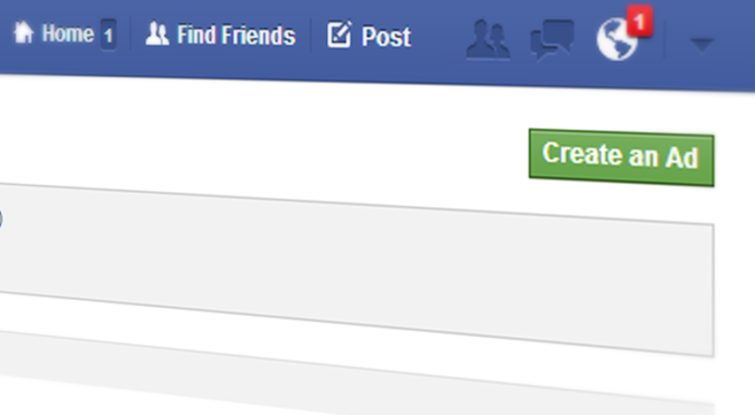
CLASSIC ADS
Technique for increasing likes or driving website clicks

Slide 39
CONTESTS
MARKETING TACTIC THAT CAN INCREASE FANS AND BRAND AWARENESS. BUSINESSES MUST USE A THIRD-PARTY APP FOR CREATING THEIR FACEBOOK CONTEST, THEN DIRECT USERS TO THE APP FROM THEIR FACEBOOK PAGE.

Slide 40
PROMOTED POSTS
PAGE OWNERS PAY A FLAT RATE IN ORDER TO HAVE A SINGLE POST REACH A CERTAIN NUMBER OF USERS, INCREASING A SPECIFIC POST’S REACH AND IMPRESSIONS

Slide 41
SPONSORED STORIES
FACEBOOK CLAIMS THAT SPONSORED STORIES HAVE 46% HIGHER CTRS AND 20% LOWER CPCS THAN REGULAR FACEBOOK ADS, MAKING THEM A VERY SERIOUS STRATEGY FOR MARKETING ON FACEBOOK
FACEBOOK AD THAT SHOWS A USER’S INTERACTIONS TO THE USER’S FRIENDS
FACEBOOK SPONSORED STORIES CAN BE CREATED EASILY THROUGH THE FACEBOOK AD CREATE FLOW
SEEKS TO CAPITALIZE ON THE “WORD OF MOUTH” CONCEPT

Slide 42
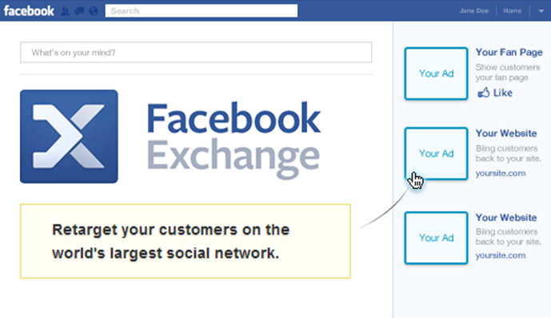
FACEBOOK EXCHANGE
AD RETARGETING ON FACEBOOK THROUGH REAL-TIME BIDDING
ADVERTISERS CAN TARGET AUDIENCES BASED ON WEB HISTORY DATA

Slide 43
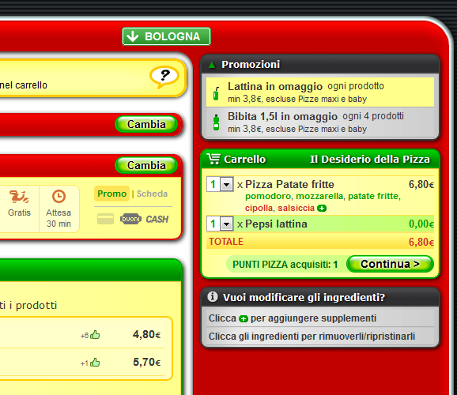








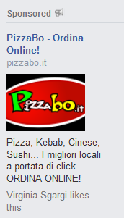
FIRST PARTY COOKIE DATA
FROM A BRAND’S OWN WEBSITE
DSP/ATD PARTNERS
1
2
3
AS WELL AS THIRD PARTY
COOKIE DATA FROM OTHER
SOURCES
TO TARGET USERS ON FACEBOOK BASED
ON THEIR PREVIOUS WEB ACTIVITY

Slide 44
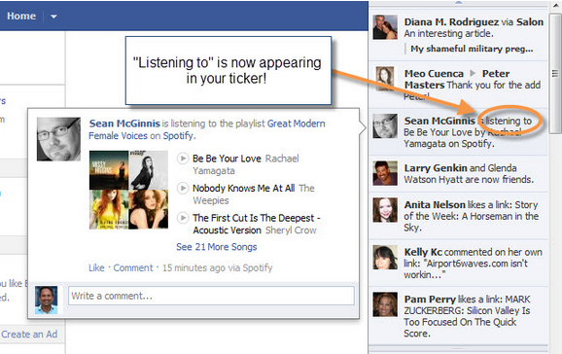
OPEN GRAPH
BUSINESSES CAN LABEL A USER’S ACTION WITH THEIR APP
BUSINESSES CAN CREATE THIRD-PARTY APPS THAT CONNECT TO A USER AND POST A NOTICE ON FACEBOOK WHEN A USER PERFORMS A SPECIFIC ACTION WITH THE APP
ALLOWS FOR CREATIVE INTERACTIVE OPTIONS OUTSIDE OF THE STANDARD “LIKE” AND “COMMENT”

Slide 45

OPEN GRAPH FRAMEWORK
USER
ACTION
OBJECT
Listen
Watch
Play
Cook
Want
Customize
Song
Movie
Game
Recipe
Shoes
Car
EXAMPLES

Slide 46
THANK YOU
THE TEAM
VALERIA DI PERSIO
CRISTINA MUÑOZ

